Slide 1
NATIONAL SOCIETY OF BLACK ENGINEERS, UTA CHAPTER
1st General Body Meeting, January, 29, 2024
Check in QR code for attendance points at the end of presentation

Slide 2
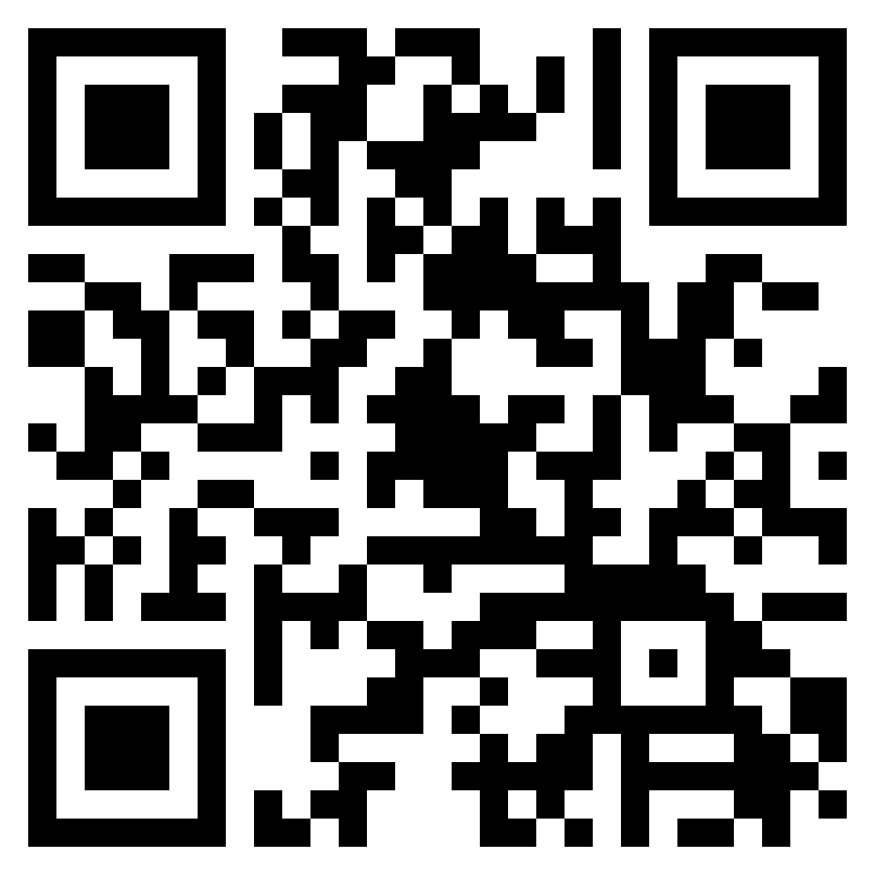
QR code sign in
Notes:
Hannah

Slide 3
Introduce the Officers
President | Oyin Bedford
Vice President | Michael Aiyedun
Treasurer | Janet George
Secretary | Andrew Hackshaw
Programs Chair | George (Trey) Hudson
Public Relations | Simara Peyton
Historian | Betty Bezabeh
Webmaster | Thomas Pinkney
Academic Excellence | Dami Djayi
Conference Planning | Anthony Aiyedun
Membership Chair | Austin Davis
Photographer | Nicholas
Notes:
Hannah

Slide 4
Ice Breaker (Rock Paper Scissors Tournament)
Create groups of 3 to 4 people
Best of 3 wins!
Whoever wins the group will advance and play another group, until we have 2 people left
The two people will play best of 5
WINNER: NSBE T-SHIRT* (Come see me afterward so I can get a T-Shirt in your size).
Notes:
Betty

Slide 5
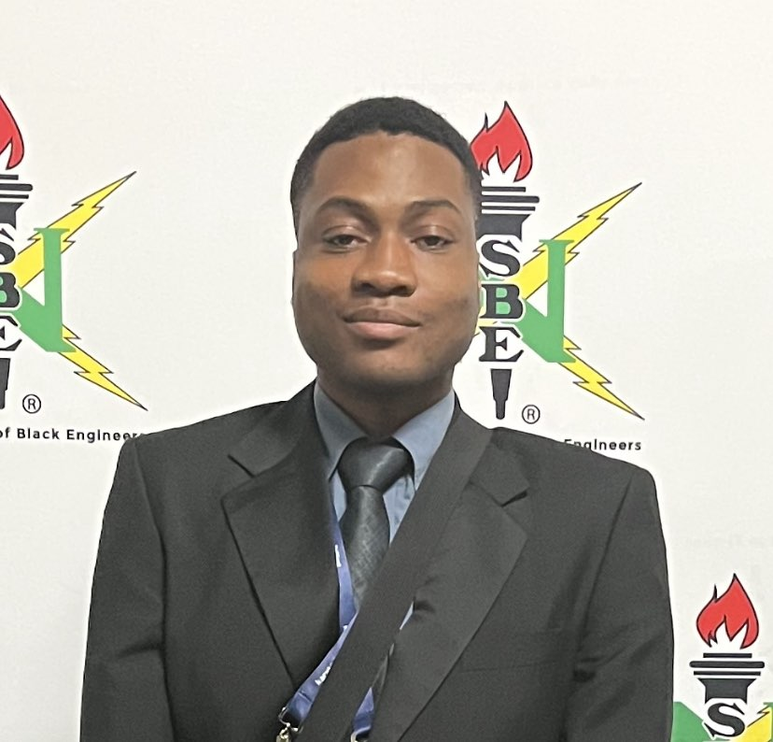
Michael Aiyedun
Classification: Graduate Student
Major: Computer Engineering
Position: Vice President
Favorite School Subject: Science
Fun fact: I’m an Artist
Which movie series is better? Star Wars or Indiana Jones
Notes:
Betty

Slide 6
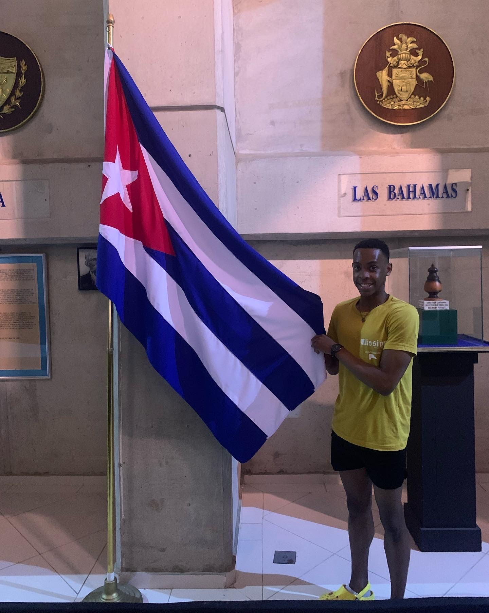
Andrew Hackshaw
Classification: Junior
Major: Biomedical engineering
Position: Secretary
Favorite School Subject: Chemistry
Fun fact: I’ve been to every continent on the Western Hemisphere
Which movie series is better? Star Wars or Indiana Jones
Notes:
Betty

Slide 7
Oyin Bedford
Classification: Junior
Major: Aerospace Engineering
Position:President
Favorite School Subject: Science
Fun fact: I like to make video games!
Which movie series is better? Star Wars or Indiana Jones
Notes:
Betty

Slide 8
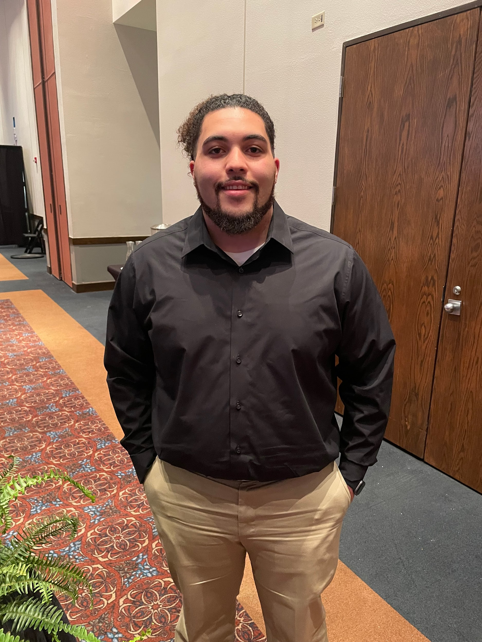
Trey Hudson
Classification: Junior
Major: Construction Management
Position: Programs Chair
Favorite School Subject: Math
Fun fact: I liked to play video games!
Which movie series is better? Star Wars or Indiana Jones
Notes:
Betty

Slide 9
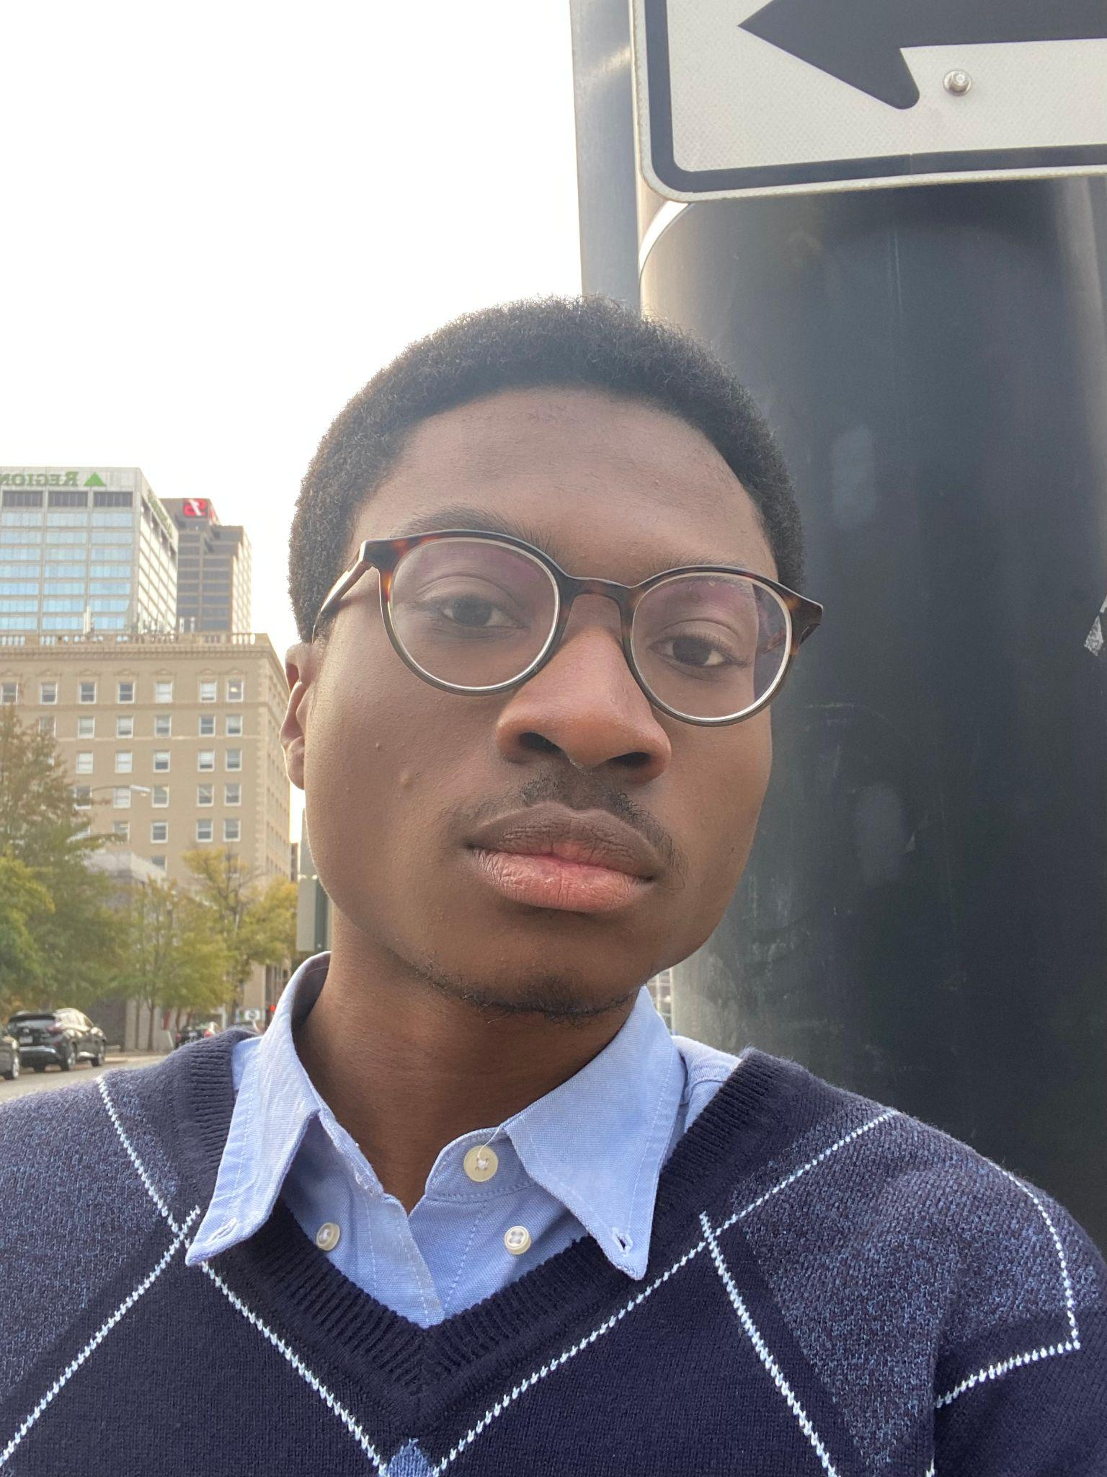
Anthony Aiyedun
Classification: Junior
Major: Mechanical Engineering w/ Physics minor
Position: Conference Coordinator/Senator
Favorite School Subject: Physics
Fun fact: I’m currently in 2 undergraduate research lab opportunities at UTA.
Which movie series is better? Star Wars or Indiana Jones
Notes:
Betty

Slide 10
Betty Bezabeh
Classification: Junior
Major: Computer Science
Position: Historian
Favorite School Subject: Math
Fun fact: I’m allergic to watermelon
Which movie series is better? Star Wars or Indiana Jones
Notes:
Betty

Slide 11
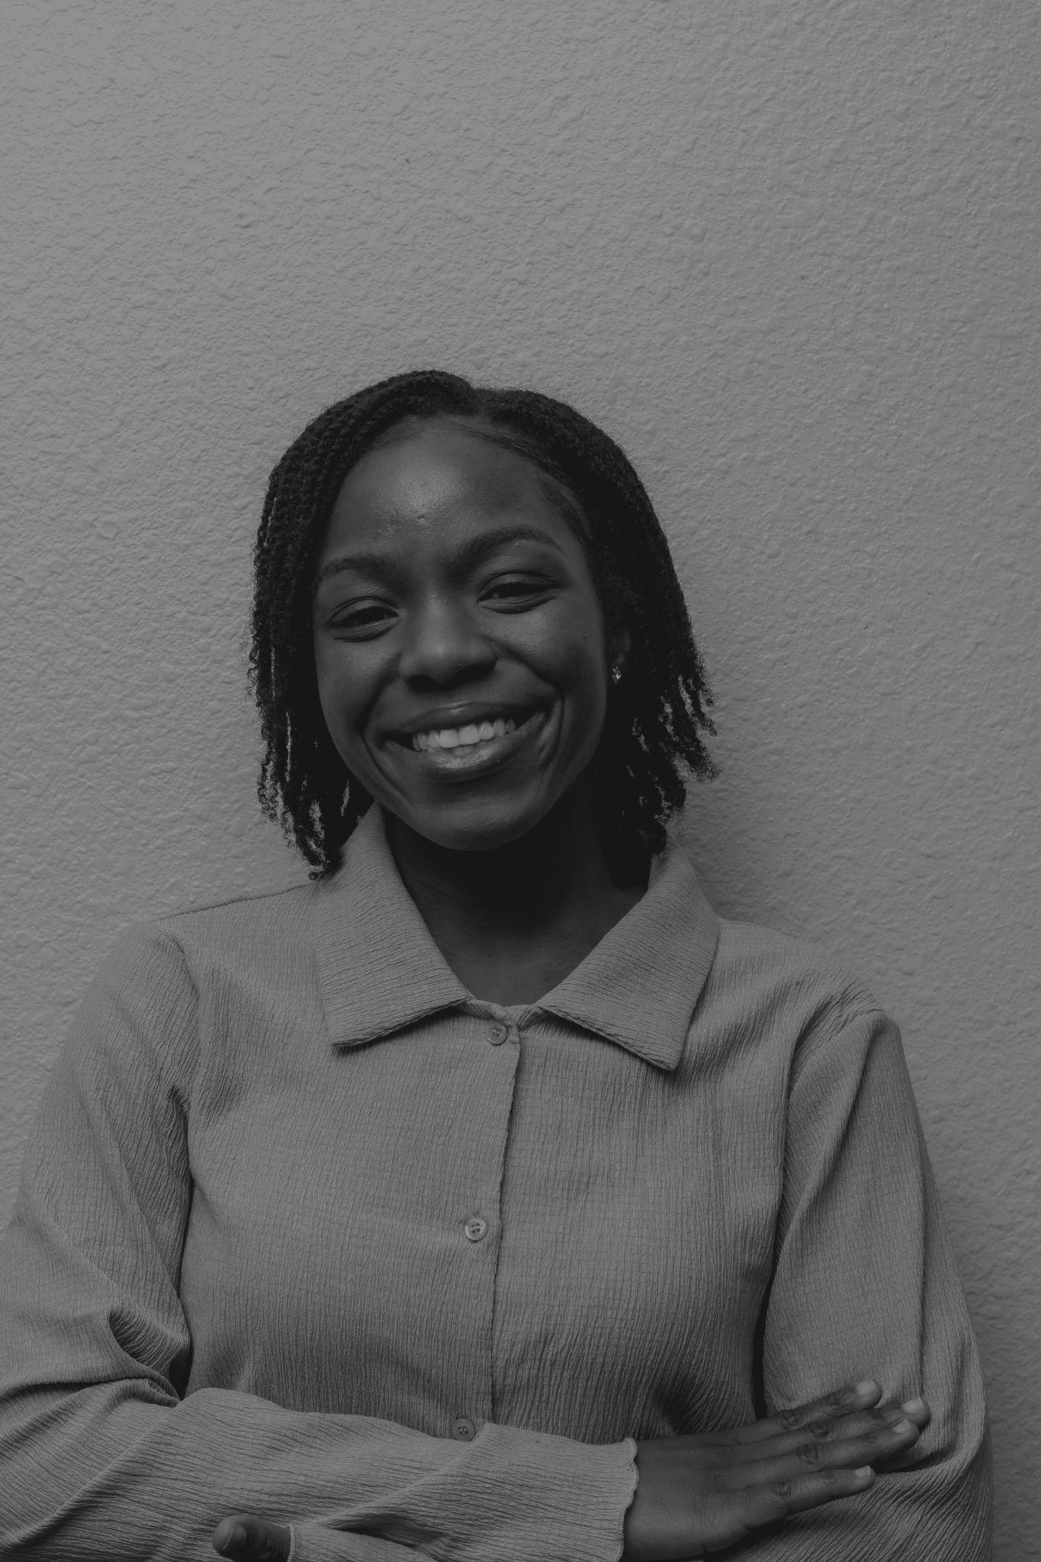
Janet George
Classification: Junior
Major: Electrical Engineering
Position:Treasurer
Favorite School Subject: Mathematics
Fun fact: I love to dance!
Which movie series is better? Star Wars or Indiana Jones
Notes:
Betty

Slide 12
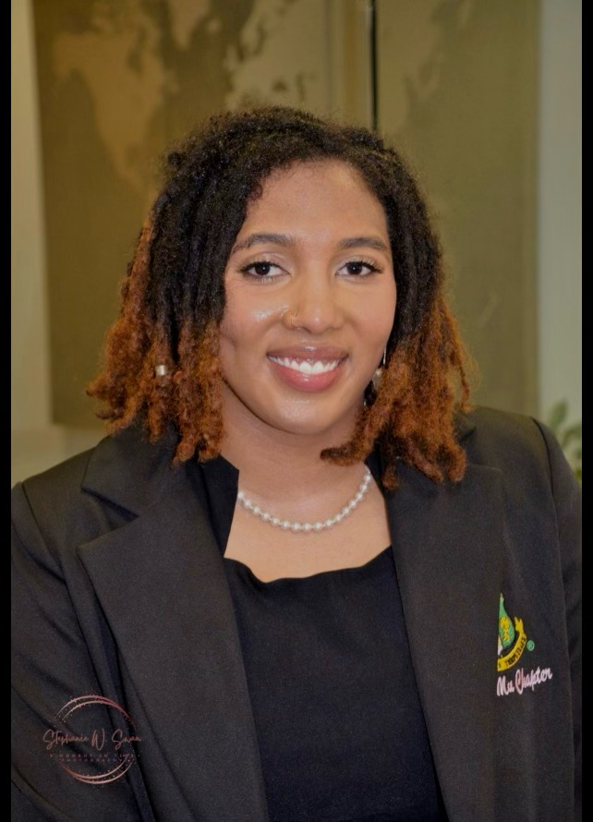
Simara Peyton
Classification: Junior
Major: Computer Engineering
Position:Public Relations
Favorite School Subject: Math
Fun fact: I love volleyball! :)
Which movie series is better? Star Wars or Indiana Jones
Notes:
Betty

Slide 13
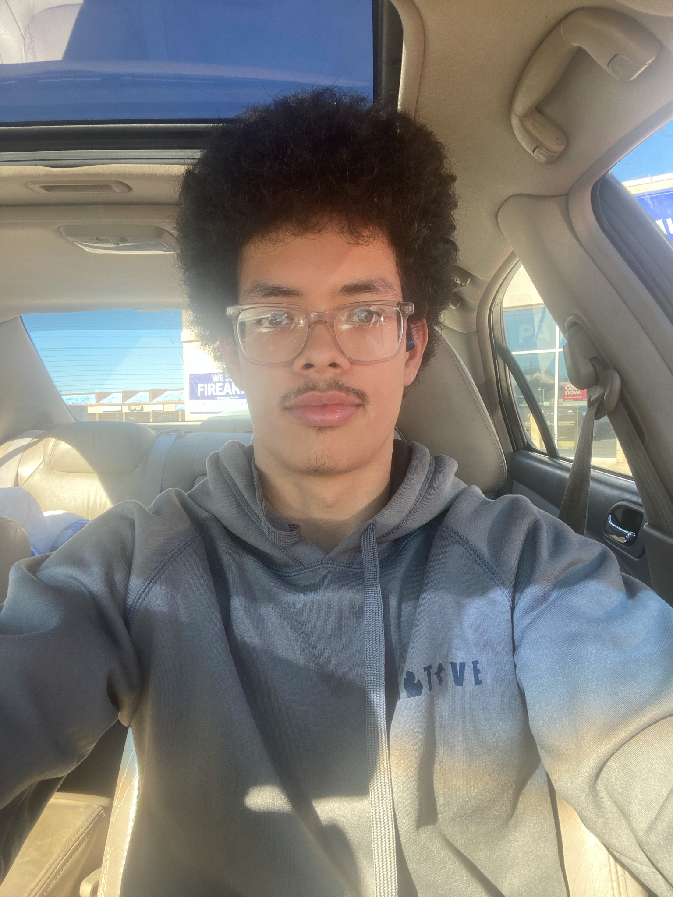
Nicholas Page
Classification: Sophomore
Major: Computer Science
Position:Photographer
Favorite School Subject: Math
Fun fact: I love to design games
Which movie series is better? Star Wars or Indiana Jones
Notes:
Betty

Slide 14
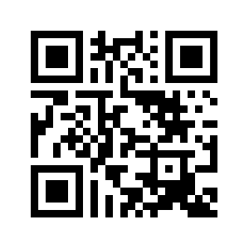
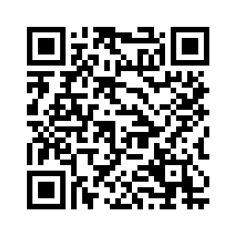
Membership
Pay Dues
Chapter dues: $30 on utansbe.org
Membership > Join Now!
National dues: $18 on nsbe.org
Membership > Collegiate membership > Join Today
Chapter
National
Notes:
Anthony

Slide 15
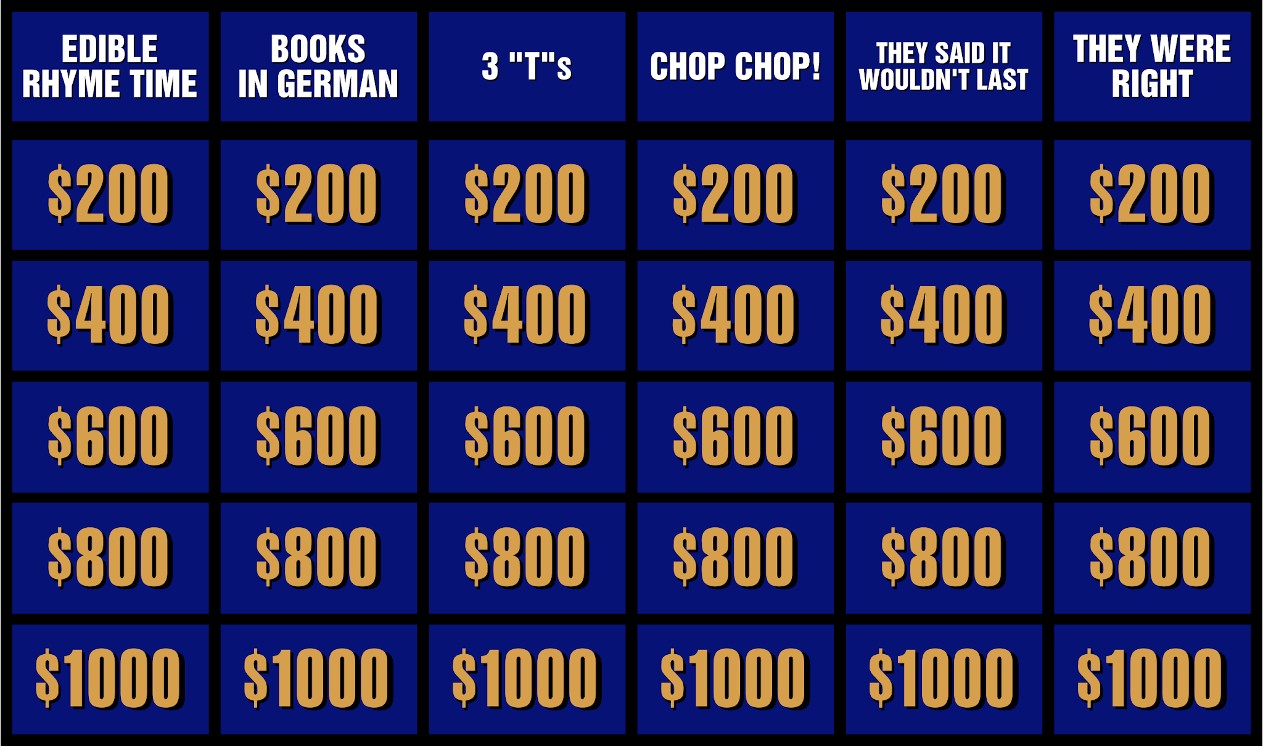
Ace that Exam, Tame the Stress:
NSBE & ASO Present "How to Survive the Semester!"
Collaborate with fellow Mavs, gain valuable insights, and have some fun while you prepare for a thriving semester!
Follow NSBE & ASO on social media for updates and sneak peeks at the Jeopardy questions!
@uta_aso
Notes:
Anthony

Slide 16
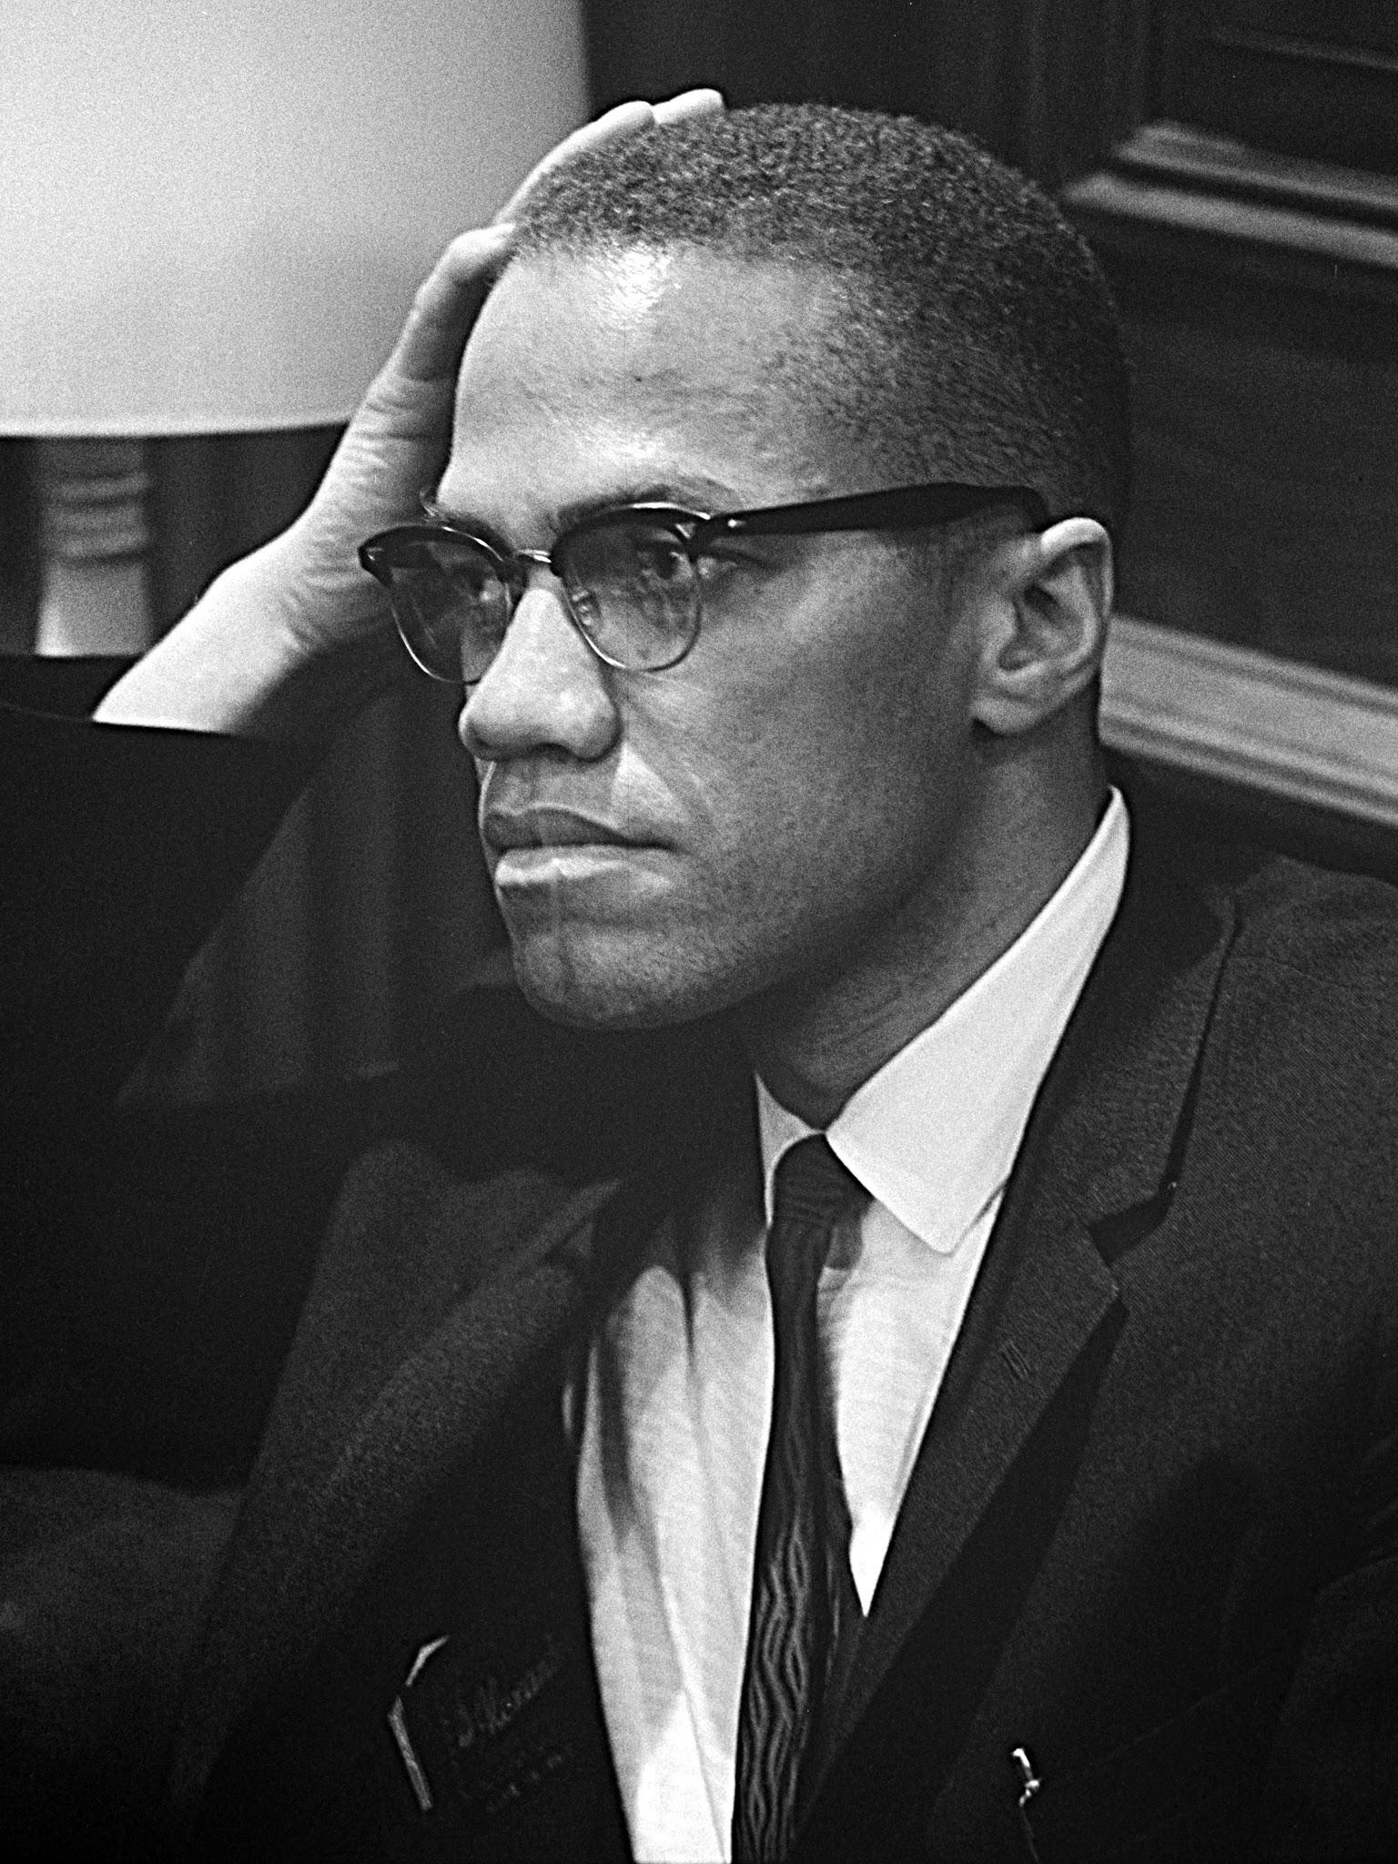
Real Stories, Real Heroes: Immerse Yourself in Black Excellence with NSBE
Save the date! Feb 16. Movie voting open to all NSBE members!

Slide 17
Things to Look Out For…
NSBE Alumni Speaker – February 5th
How to Survive This Semester with NSBE and ASO - February 9th
Valentines Day Fundraiser – February 14th
Black History Movie Night – February 16th
NSBE Bridge Building Competition – February 23rd
Volunteer Event – February TBD
Workshops – February TBD
Engineering Speaker Series - Entire Month of April
Next General Body Meeting February 26th (1-2pm)!
Notes:
Betty

Slide 18
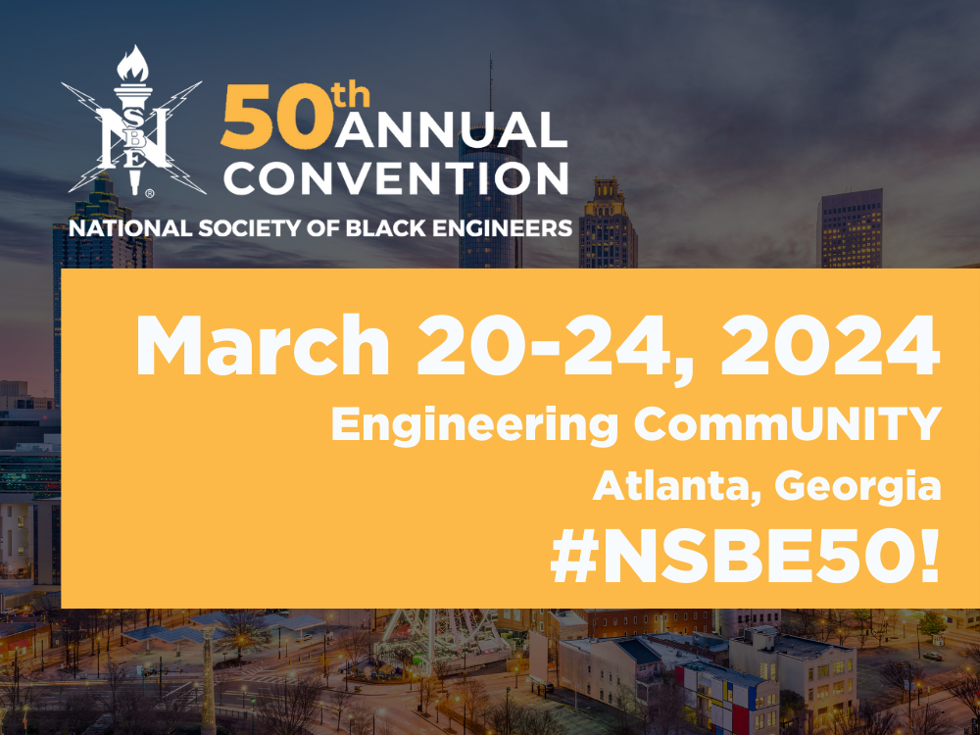
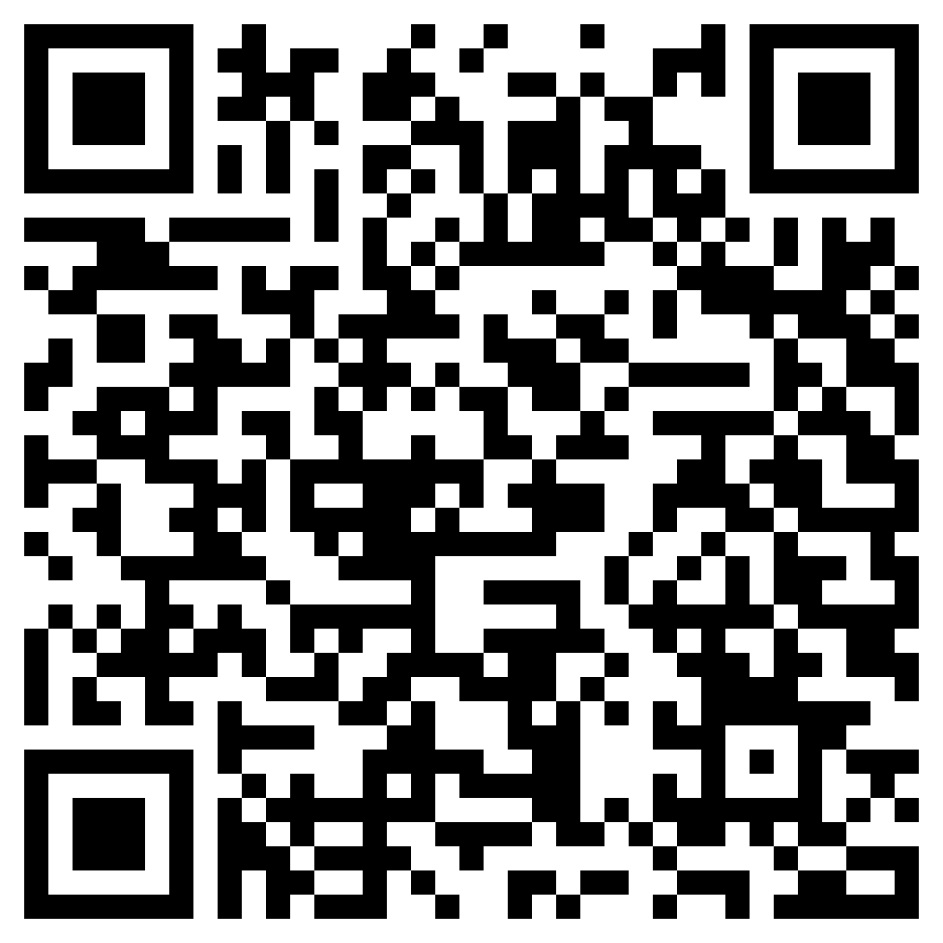
NSBE National Conference 2024
Notes:
Andrew

Slide 19
National Conference 2024
Important Steps to take if you plan on attending:
1. Double Check with your professors and syllabus for March 20th - 24th
2. Make sure you pay your $30 NSBE Chapter Dues.
3. Make sure to pay your $15 National NSBE Dues
4. Make sure to purchase your NSBE National Ticket, the next slide will discuss prices.
5. Attend NSBE Conference Info sessions.
Notes:
Andrew

Slide 20
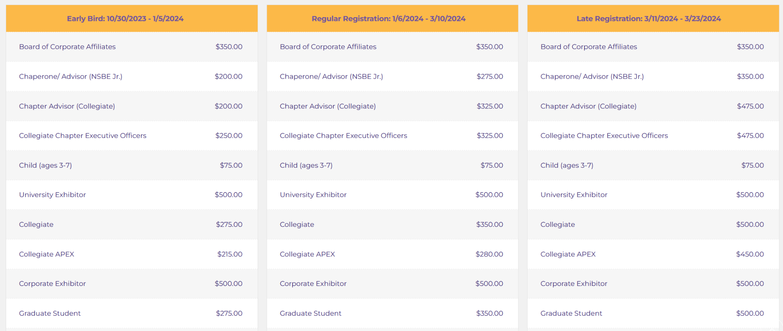
Prices
Notes:
Andrew

Slide 21
IBM Speaker
Notes:
Betty

Slide 22
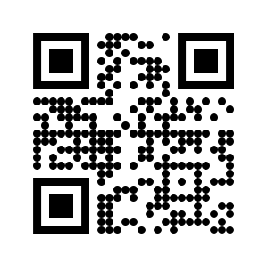
Connect with us!
Twitter: @UTA_NSBE
Instagram: @UTA_NSBE
Email: uta.nsbe.president@gmail.com
Website: www.utansbe.org
Discord!
Notes:
Simara

