Slide 1
NATIONAL SOCIETY OF BLACK ENGINEERS, UTA CHAPTER
2nd General Body Meeting, February 26, 2024

Slide 2
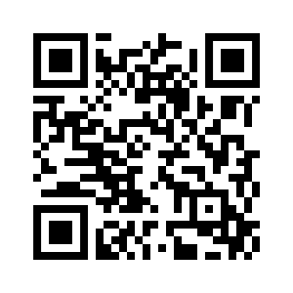
QR code sign in
Notes:
Hannah

Slide 3
Introduce the Officers
President | Oyin Bedford
Vice President | Michael Aiyedun
Treasurer | Janet George
Secretary | Andrew Hackshaw
Programs Chair | George (Trey) Hudson
Public Relations | Simara Peyton
Historian | Betty Bezabeh
Webmaster | Thomas Pinkney
Academic Excellence | Dami Djayi
Conference Planning | Anthony Aiyedun
Membership Chair | Austin Davis
Photographer | Nicholas
Notes:
Hannah

Slide 4
Ice Breaker!
Everyone quiet!
Line up in birthday order
BUT, you can’t talk.
We’ll see how accurate you get!
Notes:
Betty

Slide 5
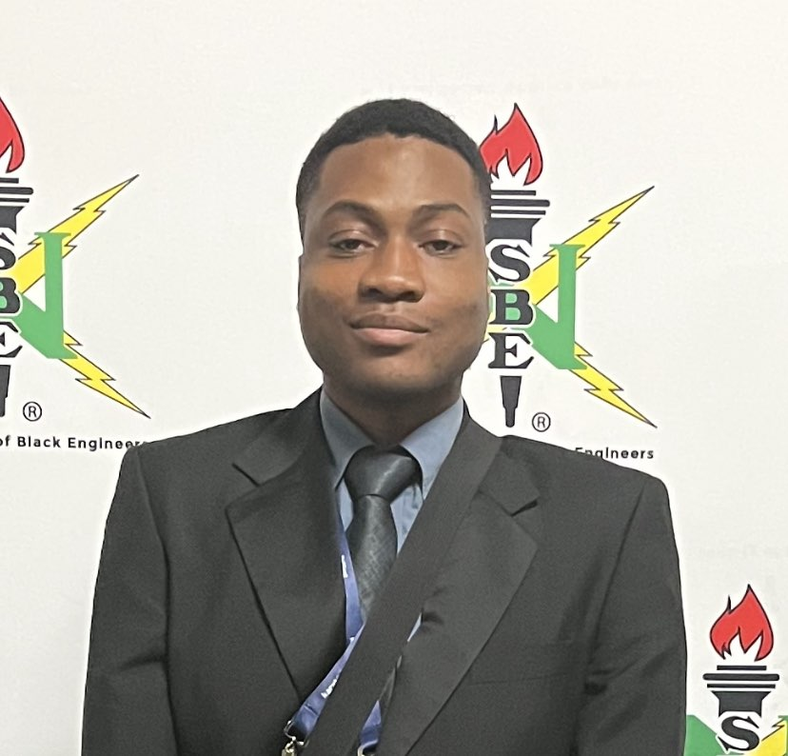
Michael Aiyedun
Classification: Graduate Student
Major: Computer Engineering
Position: Vice President
Favorite School Subject: Science
Fun fact: I’m an Artist
Notes:
Betty

Slide 6
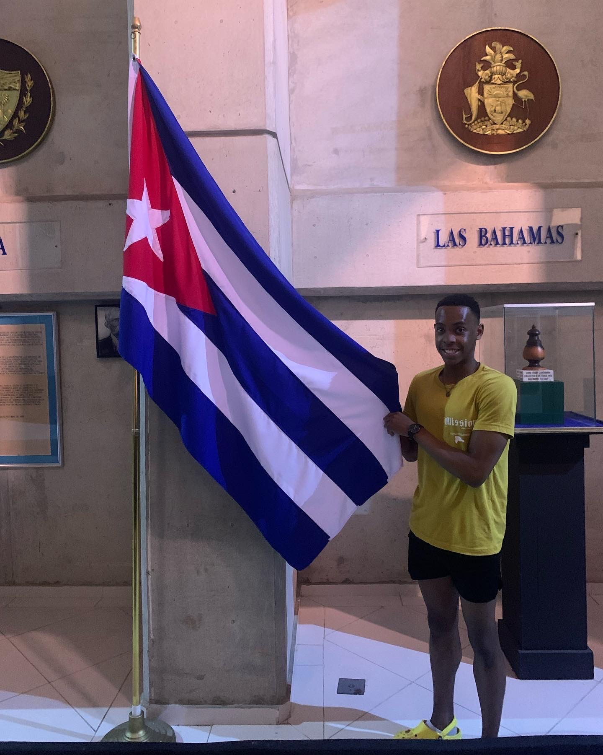
Andrew Hackshaw
Classification: Junior
Major: Biomedical engineering
Position: Secretary
Favorite School Subject: Chemistry
Fun fact: I’ve been to every continent on the Western Hemisphere
Notes:
Betty

Slide 7
Oyin Bedford
Classification: Junior
Major: Aerospace Engineering
Position:President
Favorite School Subject: Science
Fun fact: I like to make video games!
Notes:
Betty

Slide 8
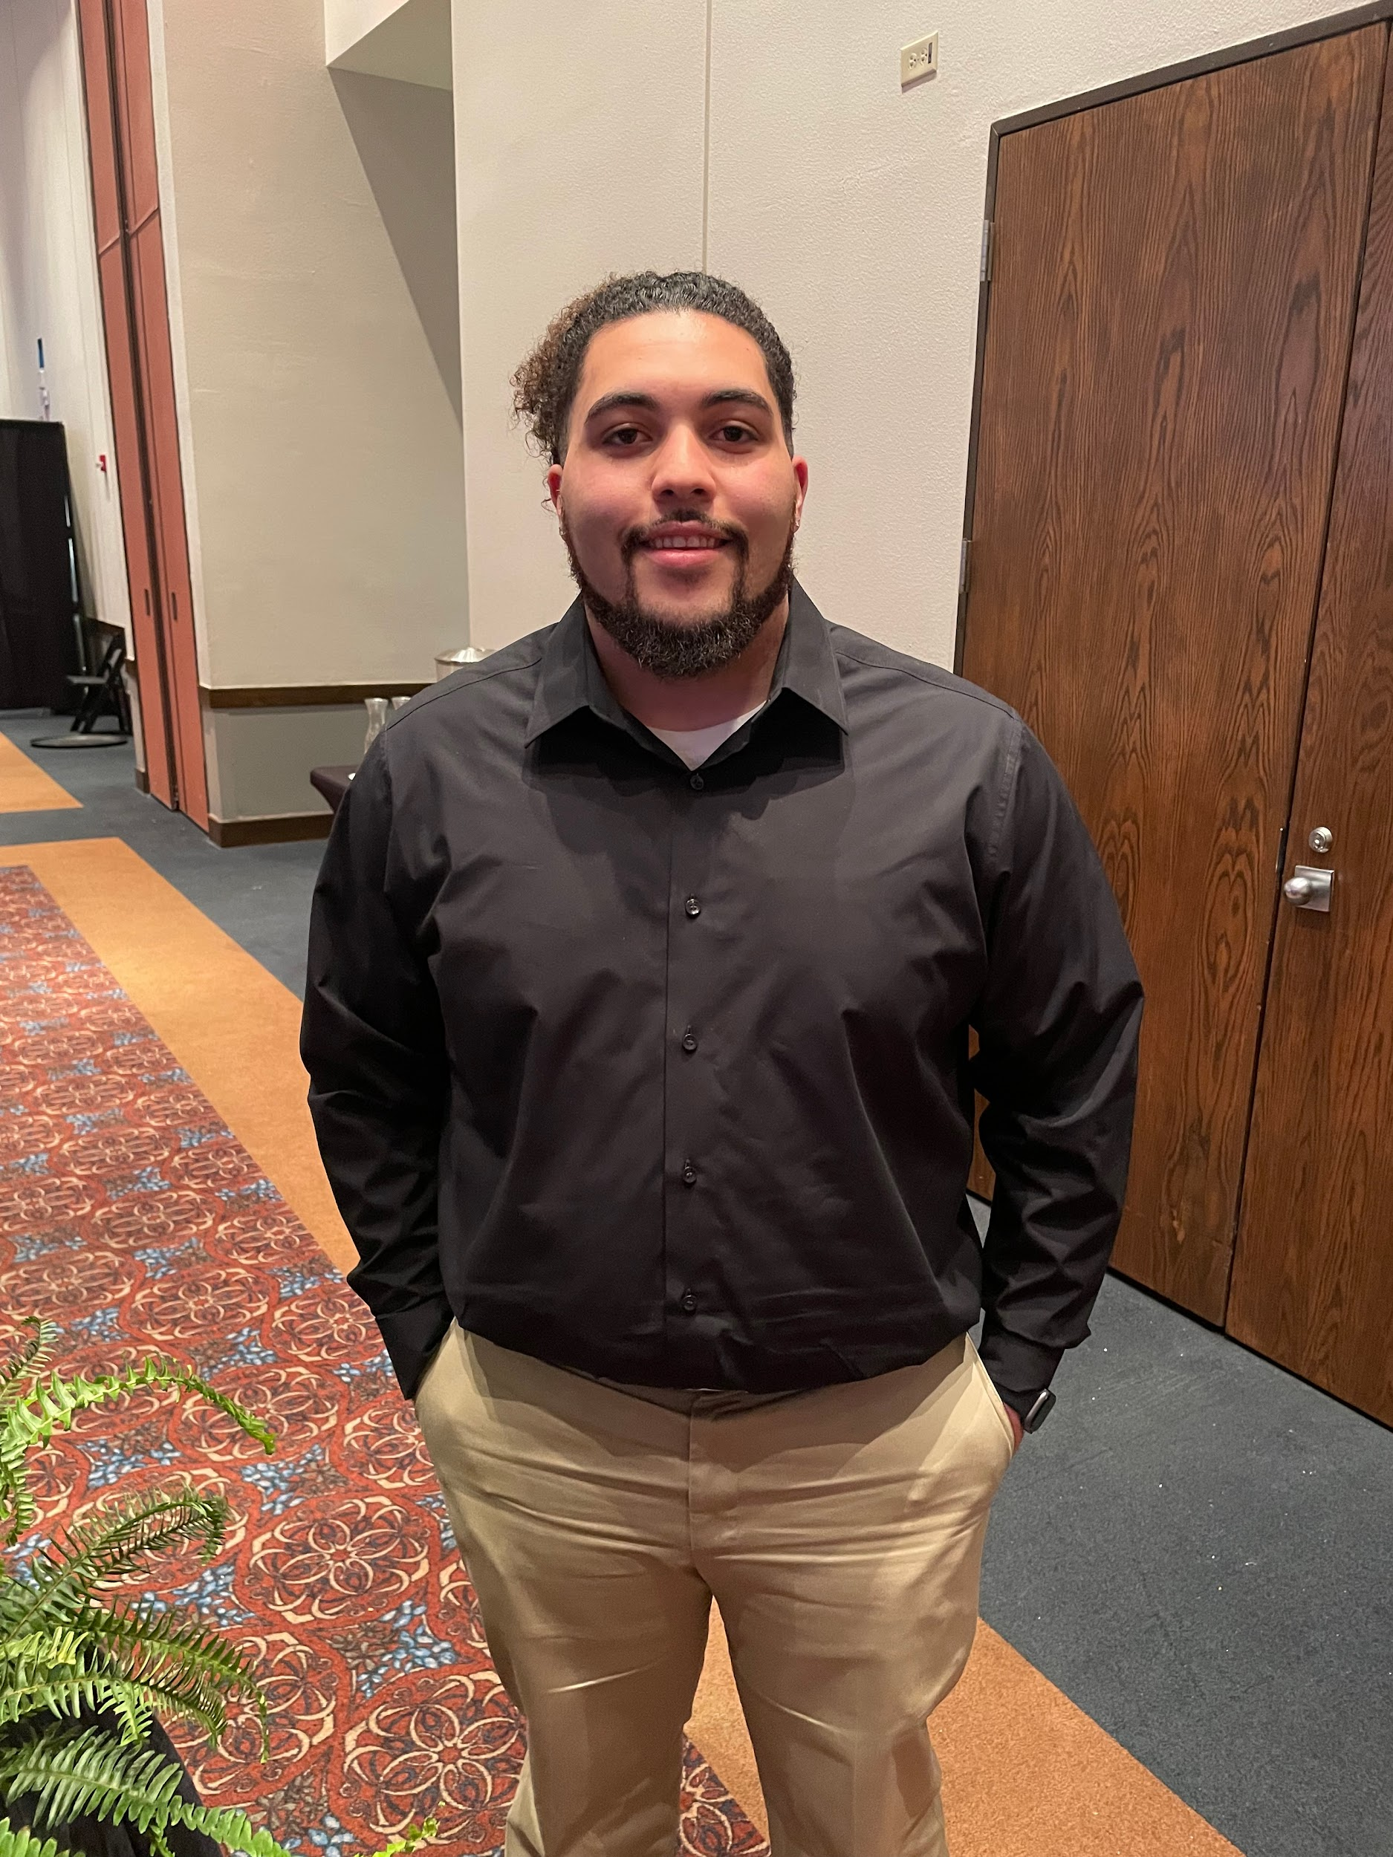
Trey Hudson
Classification: Junior
Major: Construction Management
Position: Programs Chair
Favorite School Subject: Math
Fun fact: I liked to play video games!
Notes:
Betty

Slide 9
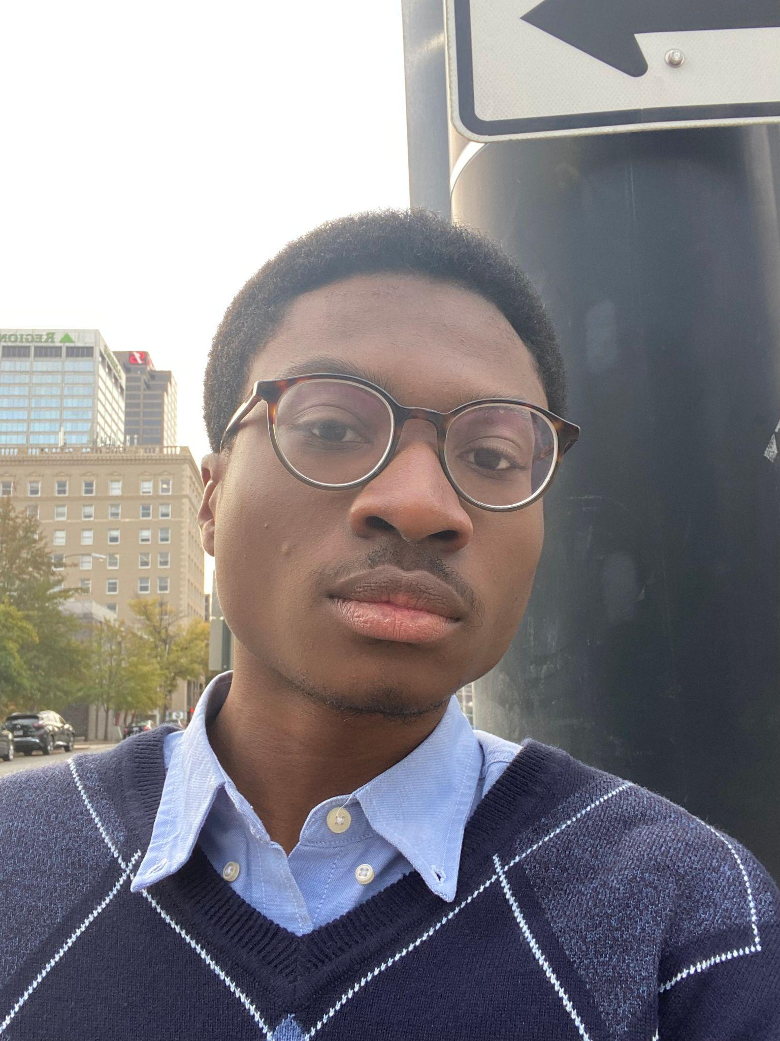
Anthony Aiyedun
Classification: Junior
Major: Mechanical Engineering w/ Physics minor
Position: Conference Coordinator/Senator
Favorite School Subject: Physics
Fun fact: I’m currently in 2 undergraduate research lab opportunities at UTA.
Notes:
Betty

Slide 10
Betty Bezabeh
Classification: Junior
Major: Computer Science
Position: Historian
Favorite School Subject: Math
Fun fact: I’m allergic to watermelon
Notes:
Betty

Slide 11
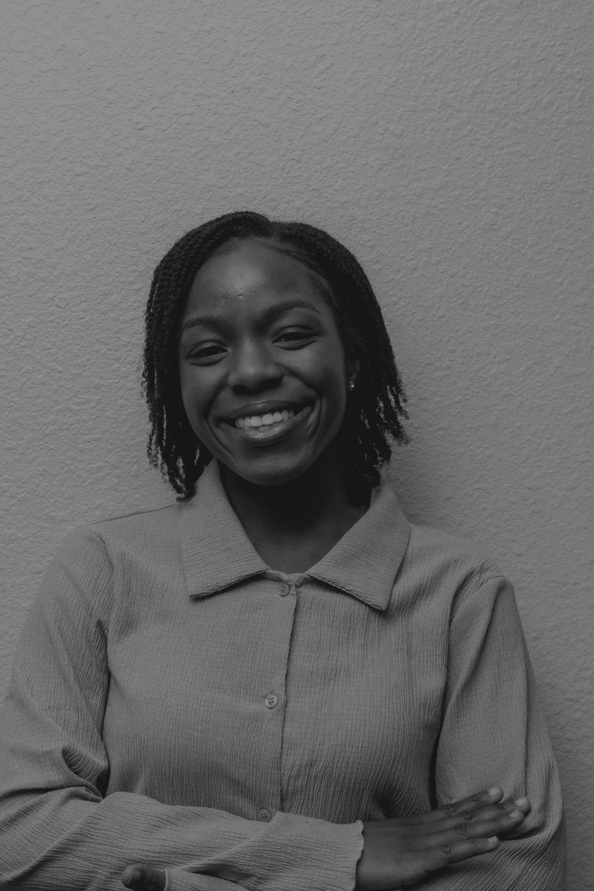
Janet George
Classification: Junior
Major: Electrical Engineering
Position:Treasurer
Favorite School Subject: Mathematics
Fun fact: I love to dance!
Notes:
Betty

Slide 12
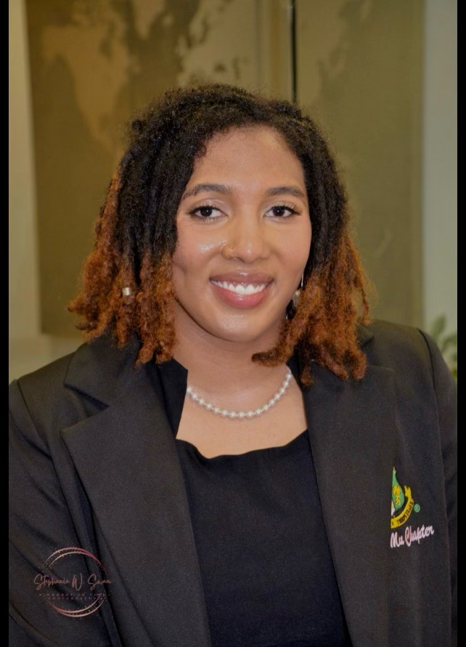
Simara Peyton
Classification: Junior
Major: Computer Engineering
Position:Public Relations
Favorite School Subject: Math
Fun fact: I love volleyball! :)
Notes:
Betty

Slide 13
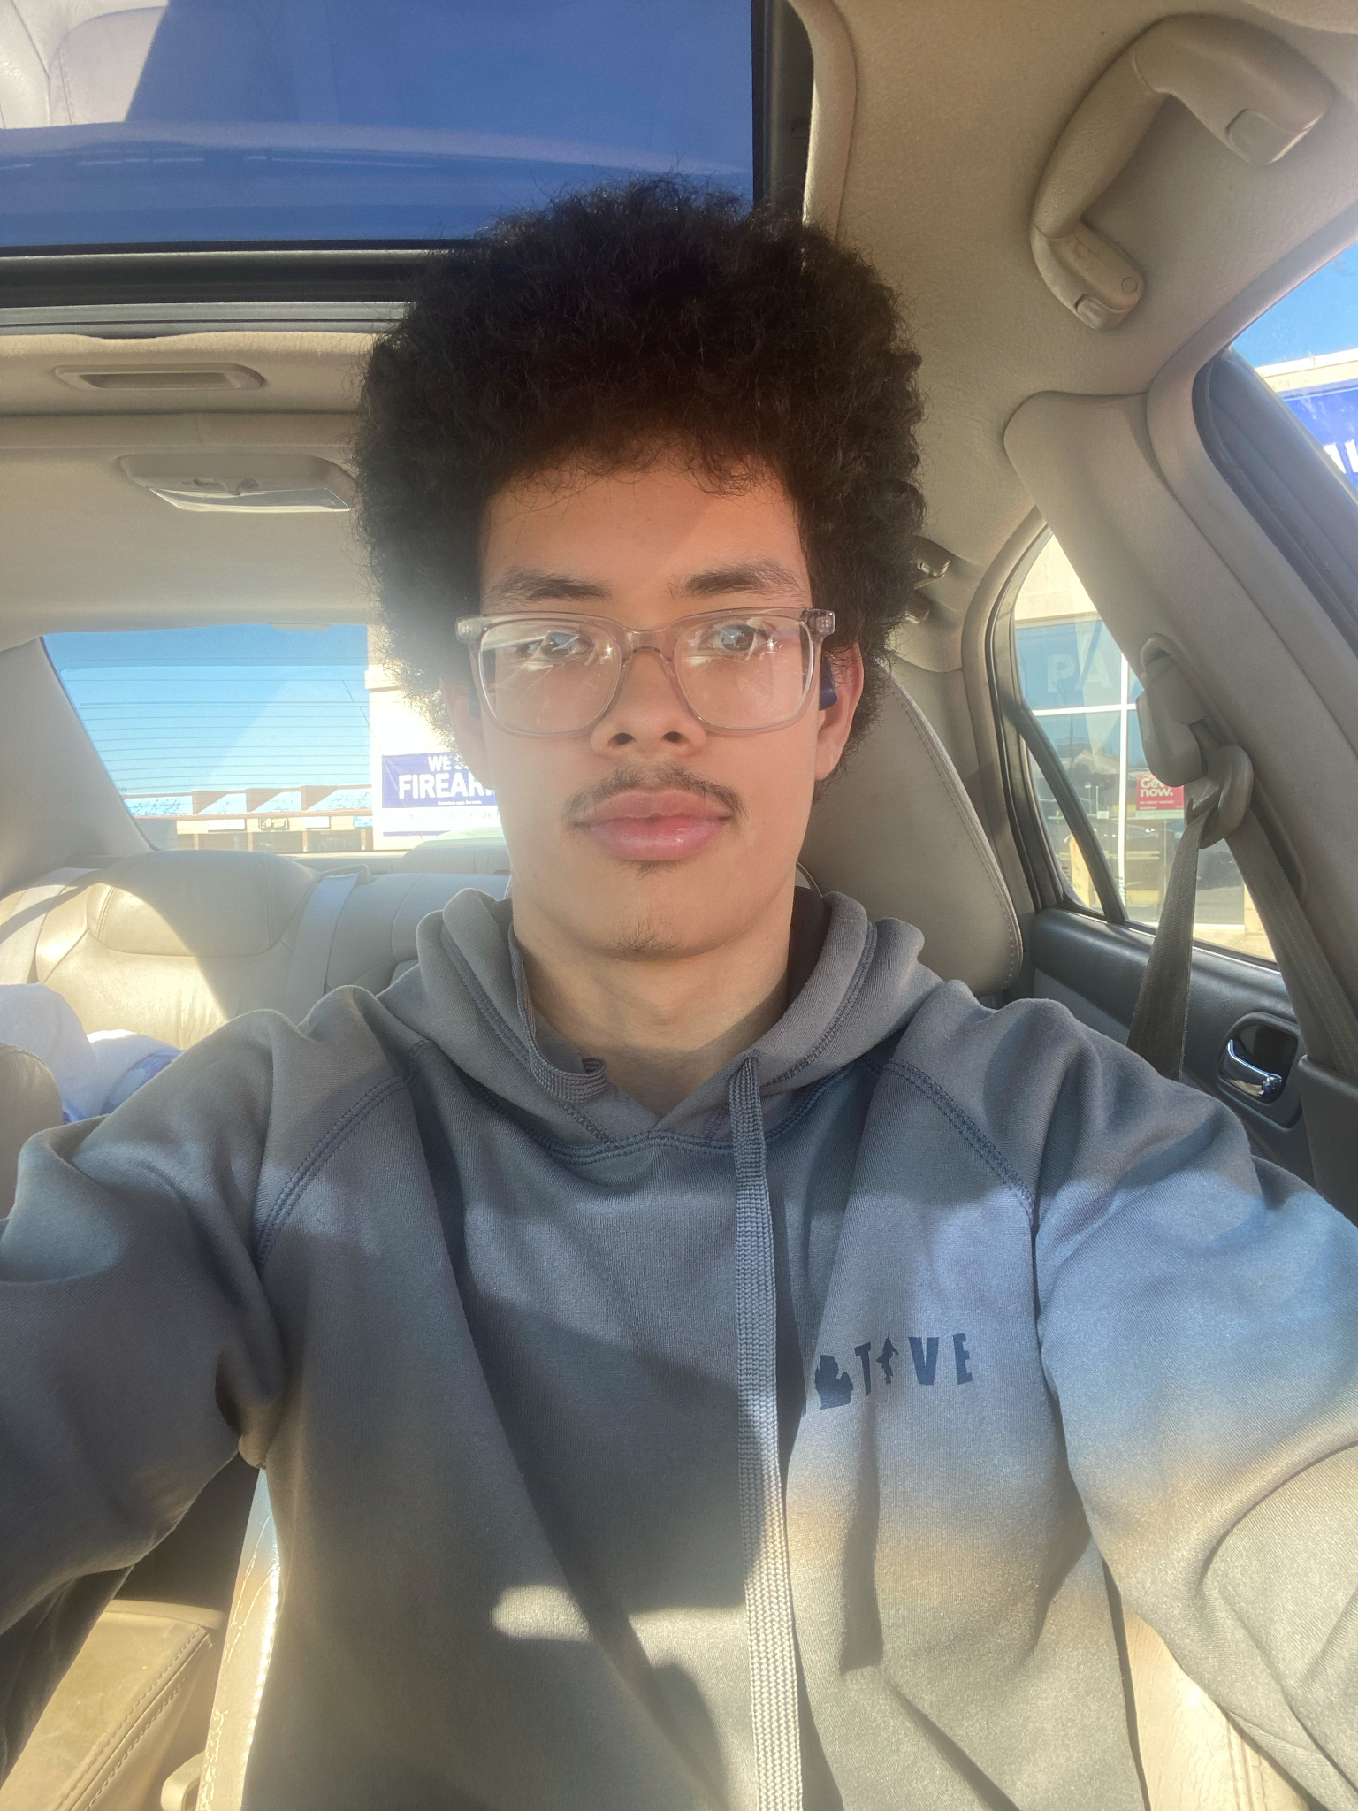
Nicholas Page
Classification: Sophomore
Major: Computer Science
Position:Photographer
Favorite School Subject: Math
Fun fact: I love to design games
Notes:
Betty

Slide 14
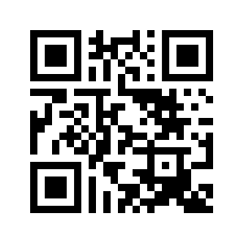
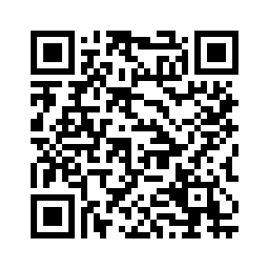
Membership
Pay Dues
Chapter dues: $30 on utansbe.org
Membership > Join Now!
National dues: $18 on nsbe.org
Membership > Collegiate membership > Join Today
Chapter
National
Notes:
Anthony

Slide 15
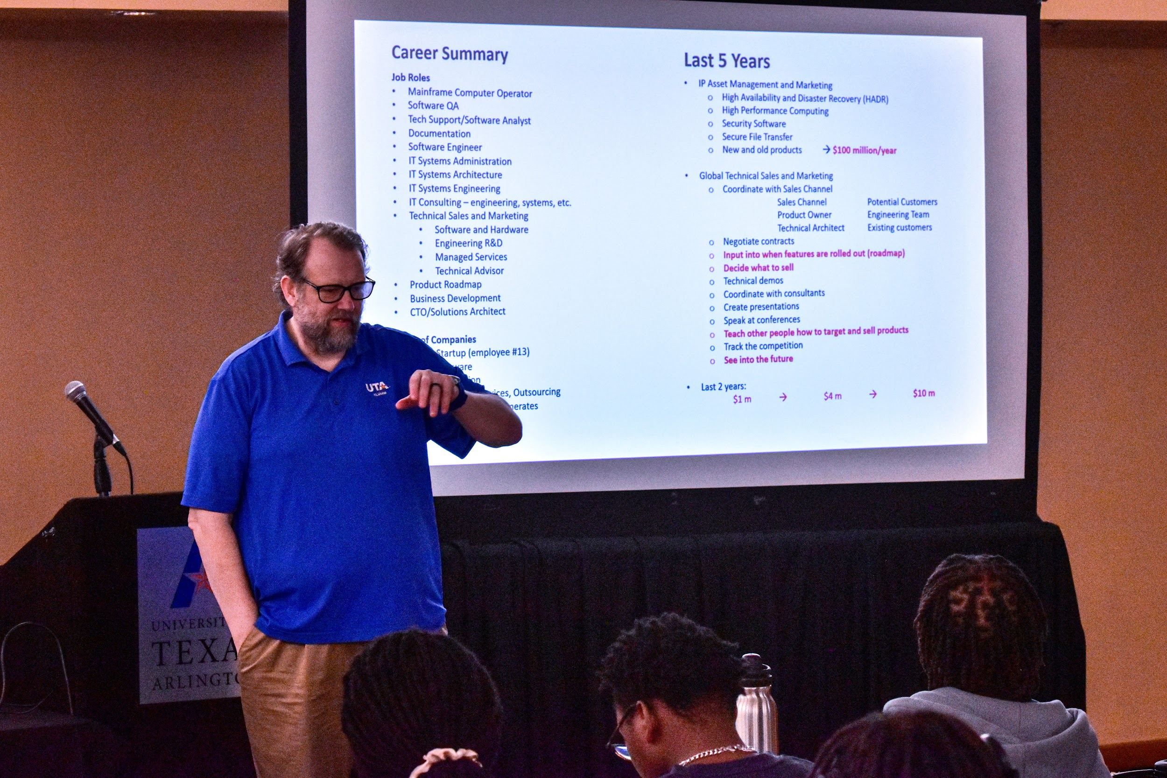
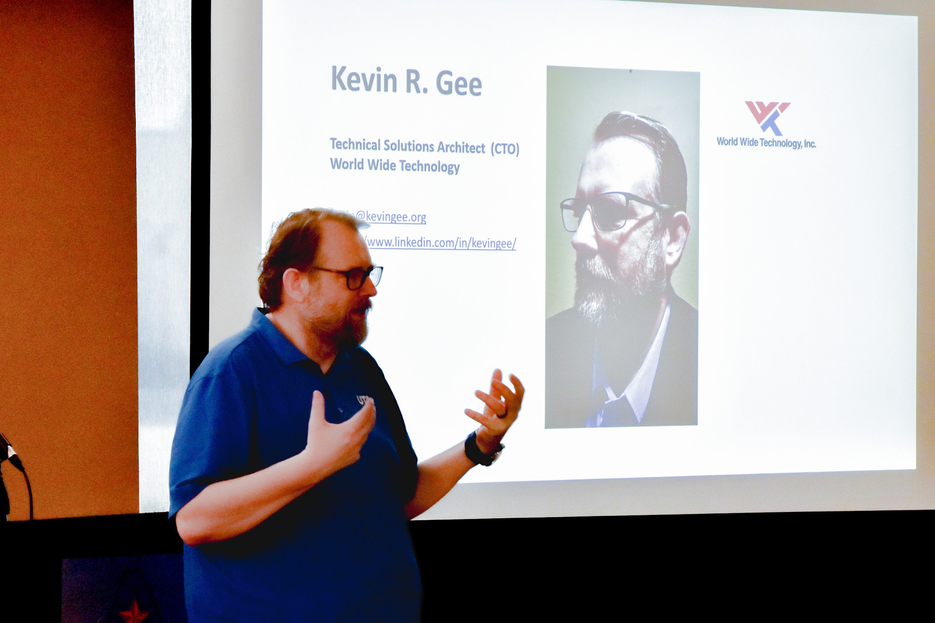
Recap!

Slide 16
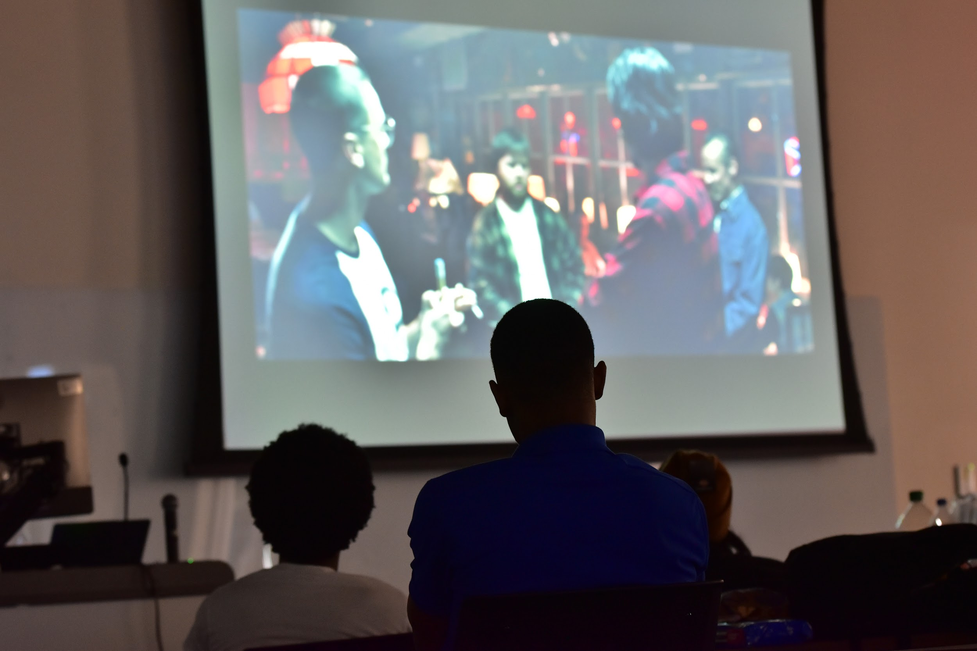
Recap!

Slide 17
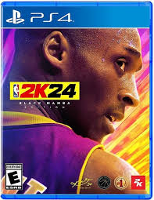
Game Night!
@uta_aso
Notes:
Anthony

Slide 18
Come Support!
February 28th
@ 12:00 - 1:00PM
Meet us in front of the UC!

Slide 19
Things to Look Out For…
Women’s History Month Event – Next week TBD
Nationals Info Session – Next week TBD
National Conference – March 20-24
Video Game Development Workshop – March/April TBD
Next General Body Meeting March 25th (1-2pm)!
Notes:
Betty

Slide 20
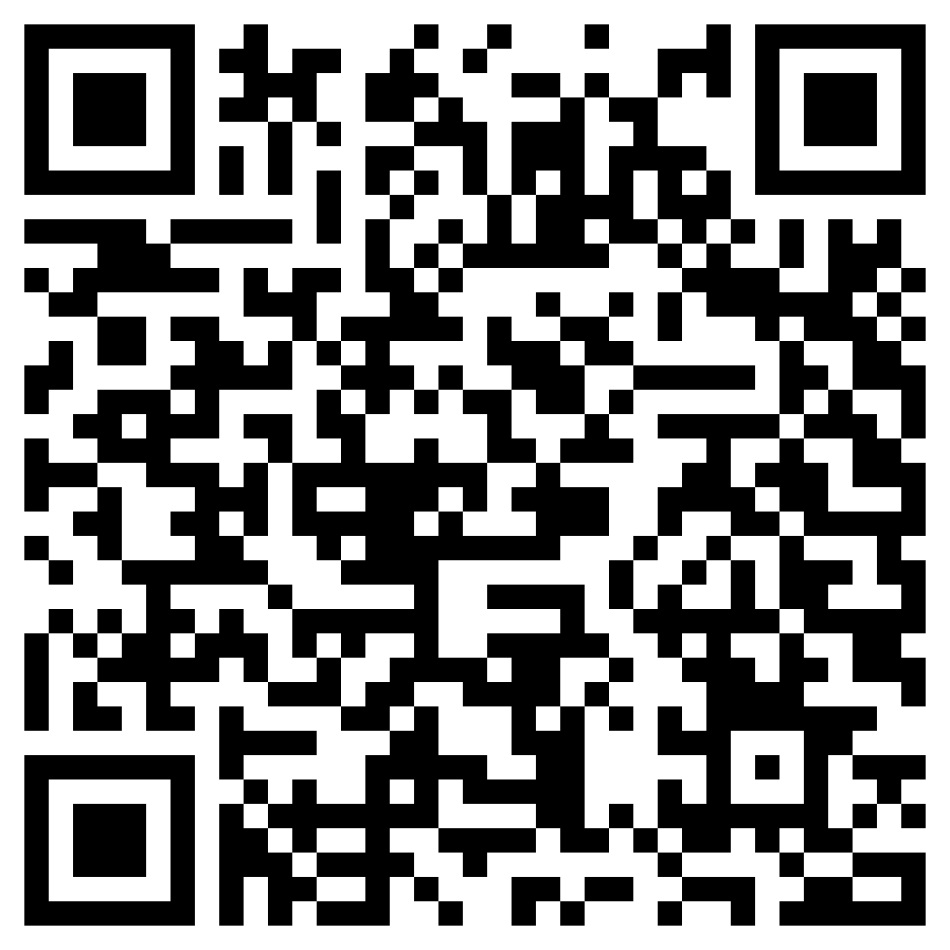
NSBE National Conference 2024
Notes:
Andrew

Slide 21
National Conference 2024
Important Steps to take if you plan on attending:
1. Double Check with your professors and syllabus for March 20th - 24th
2. Make sure you pay your $30 NSBE Chapter Dues.
3. Make sure to pay your $15 National NSBE Dues
4. Make sure to purchase your NSBE National Ticket, the next slide will discuss prices.
5. Attend NSBE Conference Info sessions.
Notes:
Andrew

Slide 22
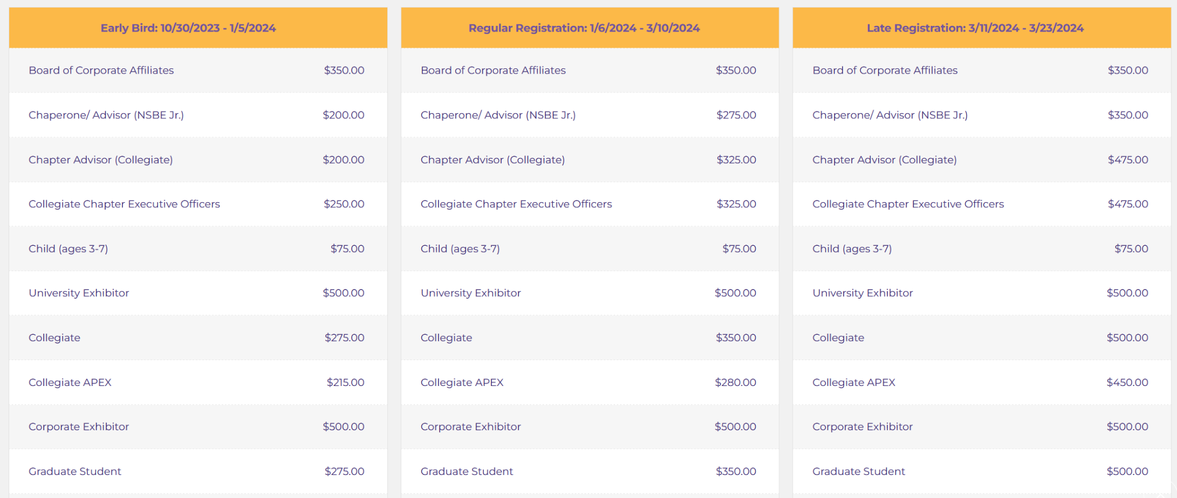
Prices
Notes:
Andrew

Slide 23
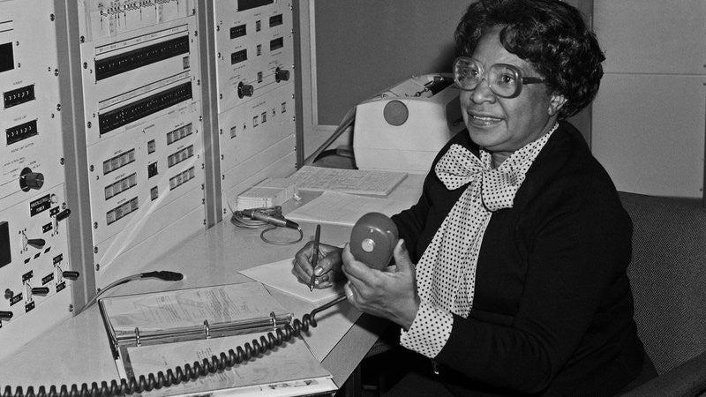
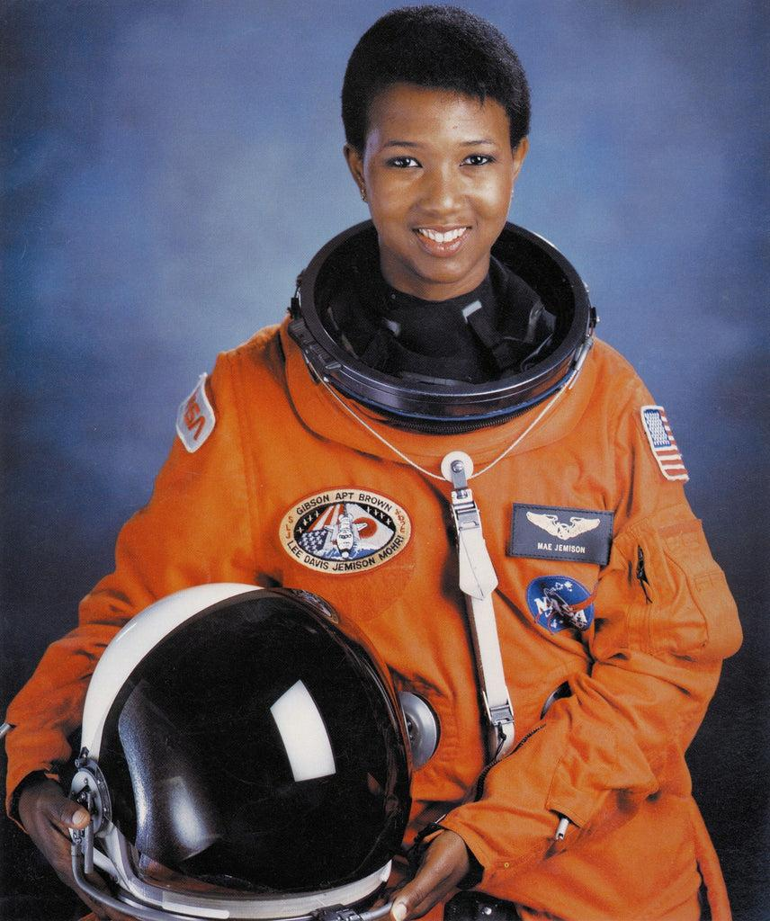
Discussion
What are some challenges you expect to/have already faced as a black engineer?

Slide 24
Discussion
What are some challenges you expect to/have already faced as a black engineer?
Why did you pick your major?

Slide 25
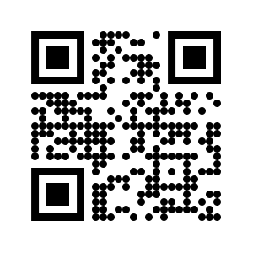
Connect with us!
Twitter: @UTA_NSBE
Instagram: @UTA_NSBE
Email: uta.nsbe.president@gmail.com
Website: www.utansbe.org
Discord!
Notes:
Simara

